Slide 1
OpenChain Monthly Meeting: Spec, Education + More
North America and Europe - 2025-07-09 @ 16:30 UTC

Slide 2

Anti-Trust Policy Notice
Linux Foundation meetings involve participation by industry competitors, and it is the intention of the Linux Foundation to conduct all of its activities in accordance with applicable antitrust and competition laws. It is therefore extremely important that attendees adhere to meeting agendas, and be aware of, and not participate in, any activities that are prohibited under applicable US state, federal or foreign antitrust and competition laws.
Examples of types of actions that are prohibited at Linux Foundation meetings and in connection with Linux Foundation activities are described in the Linux Foundation Antitrust Policy available at http://www.linuxfoundation.org/antitrust-policy. If you have questions about these matters, please contact your company counsel, or if you are a member of the Linux Foundation, feel free to contact Andrew Updegrove of the firm of Gesmer Updegrove LLP, which provides legal counsel to the Linux Foundation.

Slide 3
Agenda
Formally welcome new chairs – Specification, Education and Telco
Education Work Group – A Quick Overview of What Is Coming
AI Work Group – AI System Bill of Materials Compliance Guide – Current Status and Public Comment Period
Specification Work Group – Outcomes of the recent Steering Committee meeting – Approval of Updates to ISO/IEC 5230 and ISO/IEC 18974
Specification Work Group – Survey for ISO/IEC 5230 and ISO/IEC 18974
Any Other Business?

Slide 4
Formally Welcome New Chairs

Slide 5


Welcome 2025/2026 Chairs: Spec, Education and Telco!
Specification Chair: Chris Wood, Lockheed Martin (4th term)
Education Chair: Martin Yagi, First Light Fusion
Telco Chair: Marc-Etienne Vargenau, Nokia
(3rd term)
Election Process Overview
Notes:
Spec
Shane
Andrew
Education
Shane
Martin
Balakrishna
Andrew
Telco
Shane
Gergely

Slide 6
Education Work Group

Slide 7
Basic Next Steps (Slide 1/4)
Updates to our online training courses:
LFC193 is rated as 4.5 out of 5 stars and LFC194 is rated 4.6 out of five stars but there are some areas of potential improvement (see next slide)
Open Source Policy Template:
Reference/link to more material in reference library
Identify any training/reference material “gaps”
Maturity / Capability Model:
Reference/Link to more material in reference library + CHAOSS metrics

Slide 8
Training Courses + Material (Slide 2/4)
LFC193 could possibly add some further links to Wikipedia for the various licenses as they first come up.
LFC194 ch 02 : “Practical Activities Undertaken” : “Source Code Scanning Tools” – “A list of freely available source code scanning tools can be found at https://automatecompliance.org.” – this project seems inactive, so it may be better to link to the OpenChain Tooling Work Group
LFC194 ch 05 : Chapter Overview “NOTE: OpenChain additionally offers a one-pager set of guidelines applicable for all developers on GitHub.” – link broken!

Slide 9
Training Courses + Material (Slide 3/4)
The Online Training Course content on GitHub is not in markdown format – if we revise the courses we should consider moving to markdown:-
https://github.com/OpenChain-Project/Reference-Material/tree/master/OpenChain-Training/en/Online-Training-Courses
IIRC the Training slides were revised after the courses, so there may be some improvements to reflect back. Looking at these on github:-
https://github.com/OpenChain-Project/Reference-Material/tree/master/OpenChain-Training/en/Training-Slides/Training-Slides/en
Translations! We only have English and Italian of the current training slides for ISO/IEC 5230 – and that’s only for the Version 1, PPTX version. There is only an English version of the Version 2, DOCX + MarkDown evolution.

Slide 10
Specific Action Items (Slide 4/4)
Engage with the Linux Foundation Education folks to see if they have any improvement suggestions (and the broken link needs fixing!)
Engage with anyone we know uses/requires the courses such as Continental to see if they have any improvement suggestions
Then present any finding/suggestions and ask for wider Education input

Slide 11

AI Work Group

Slide 12
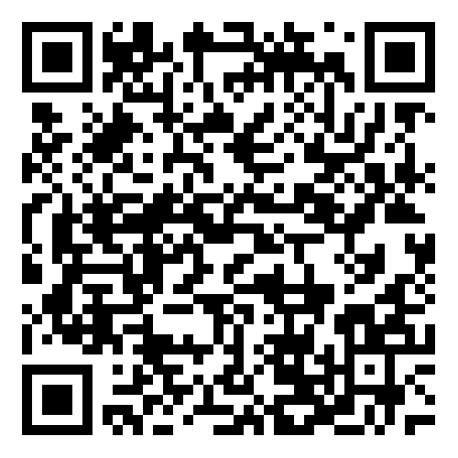
AI Compliance Draft Guide Ready (slide 1/3)
The OpenChain AI Work Group has been considering how to manage AI compliance in the supply chain for over a year. During this time, the community has collaboratively produced a draft guide to identify key process points for a quality AI compliance program:
https://github.com/OpenChain-Project/Reference-Material/blob/master/AI-SBOM-Compliance/en/Artificial-Intelligence-System-Bill-of-Materials-Compliance-Management-Guide.md
This guide was put before the OpenChain Governing Board on 2025-06-25 with a formal request for a six-week public comment period. The request was granted.
Last Work Group Meeting:

Slide 13
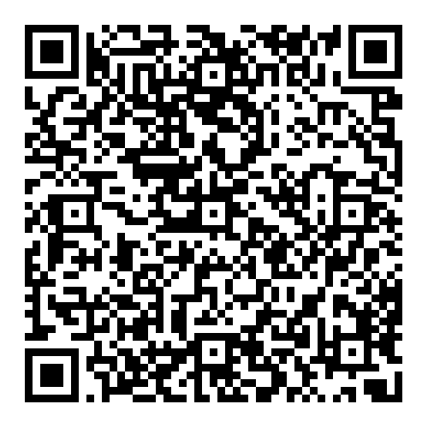
The Public Comment Period (slide 2/3)
With approval from the OpenChain Governing Board, the draft ‘The Artificial Intelligence System Bill of Materials: Compliance Management Guide for the Supply Chain’ is now entering a Public Comment Period.
This Public Comment period will follow the OpenChain Project process outlined on our website:
https://openchainproject.org/processes#process-public-comments
YOU CAN SUBMIT A COMMENT BY:
Opening an issue on the OpenChain Project Reference Library GitHub Repository: https://github.com/OpenChain-Project/Reference-Material/issues
Emailing the OpenChain AI Work Group mailing list: https://lists.openchainproject.org/g/ai
The Public Comment Period will run for six weeks.
THE DEADLINE FOR SUBMISSION OF PUBLIC COMMENTS IS 2025-08-18 AT 04:00 PDT / 11:00 UTC / 13:00 CEST / 20:00 JST.
More details
👉

Slide 14
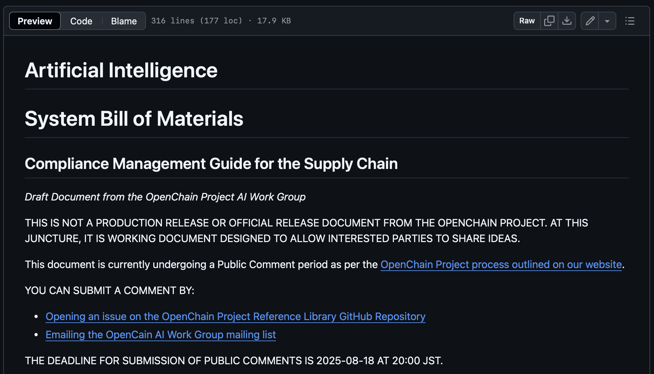

The Draft Guide (slide 3/3)
https://github.com/OpenChain-Project/Reference-Material/blob/master/AI-SBOM-Compliance/en/Artificial-Intelligence-System-Bill-of-Materials-Compliance-Management-Guide.md

Slide 15
Specification Work Group

Slide 16
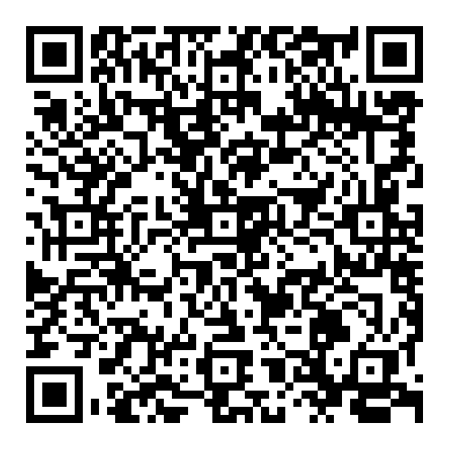
Steering Committee Meeting Outcomes
The Q2 2025 meeting was held on the 25th of June 2025 to discuss two items:
An ISO periodic review to confirm that ISO/IEC 5230 is relevant and used. This was previously confirmed by the Governing Board via email, with a formal motion passed at this meeting. No further action required.
Community proposals for future updates to ISO/IEC 5230 and ISO/IEC 18974.
Our focus will be talking about the second point for this call.
Watch the meeting
👉

Slide 17
Updates To Our Existing Standards
Suggestions for updates were collected over a 2-year period
There was a 6-month public comment period
There was a 3-month freeze period
The Steering Committee approved the suggestions on 2025-06-25. The updates will be released sometime in 2026, with the exact date to be determined.
The following 11 slides show the REDLINE changes. The primary change for both standards is adjusting the confirmation of conformance from 18 months to 12 months

Slide 18
Next Six Slides: REDLINE Details for ISO/IEC 5230

Slide 19
Context: The Links To Relevant Documents
Current ISO standard:
https://github.com/OpenChain-Project/License-Compliance-Specification/blob/master/ISO-5230-2020/en/ISO-5230-2020.md
Current Next Generation Draft (pre-public comments period):
https://github.com/OpenChain-Project/License-Compliance-Specification/blob/master/3.0/en/openchain-license-compliance-3.0.md
All open issues have been closed by the Specification Work Group
https://github.com/OpenChain-Project/License-Compliance-Specification/issues?q=is%3Aissue+is%3Aclosed

Slide 20
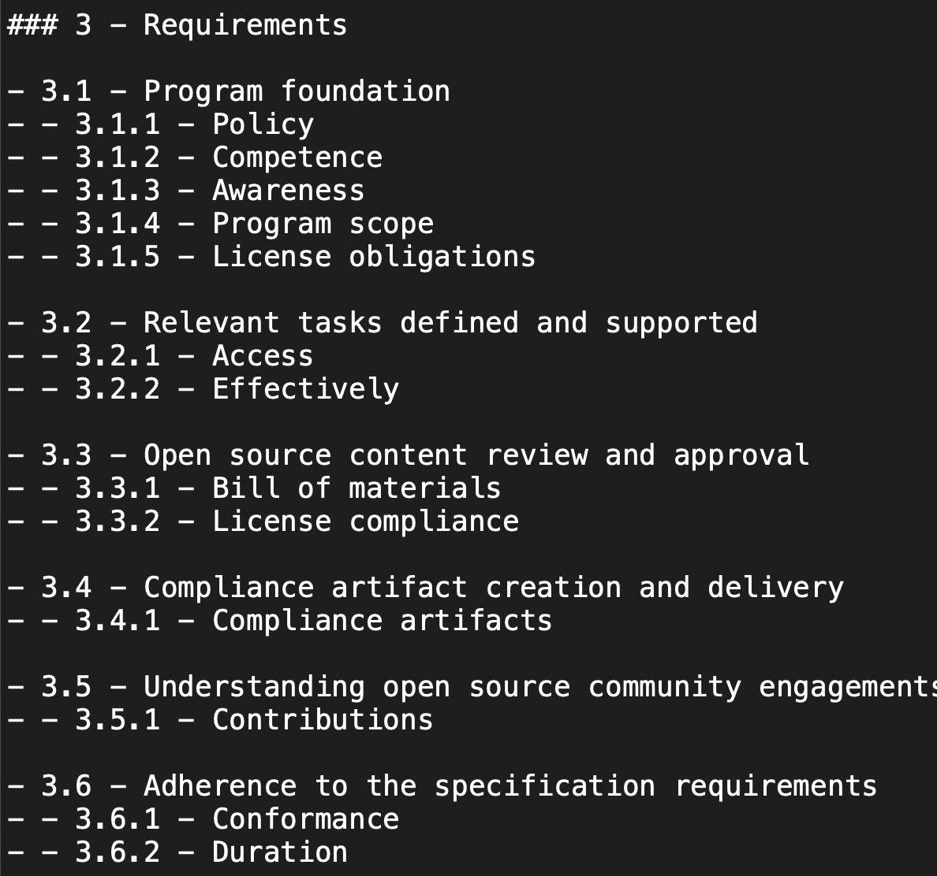
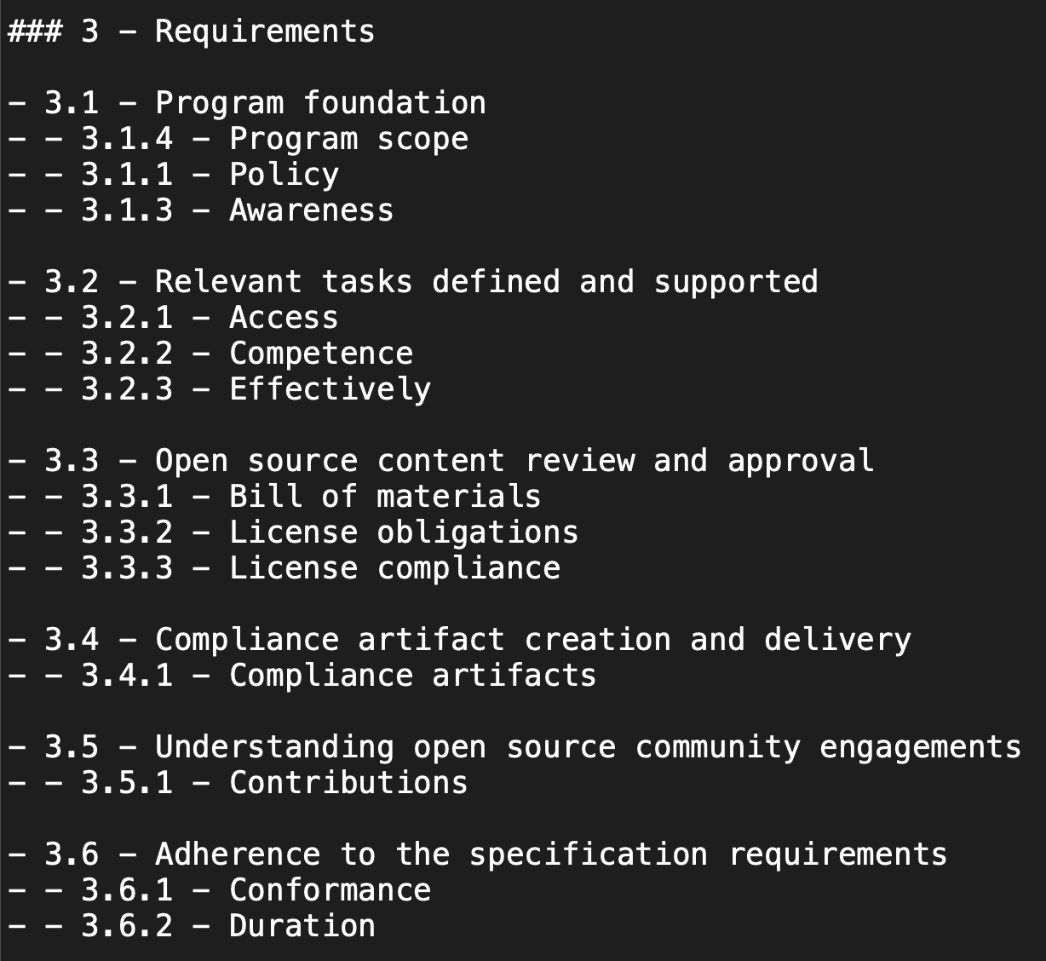
Suggestion #1 for ISO/IEC 5230:2020

Slide 21
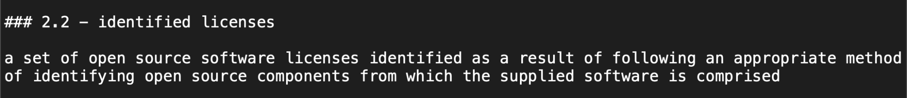
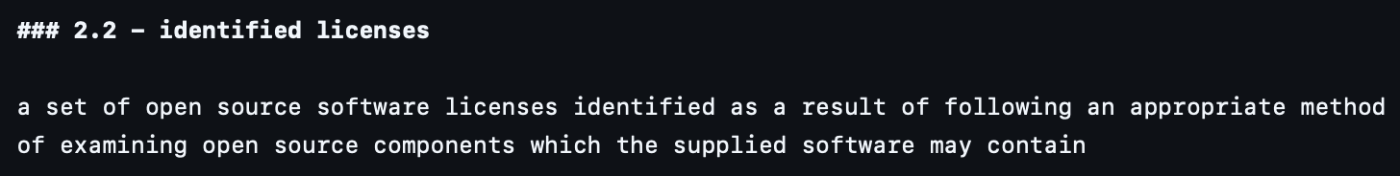
Suggestion #2 for ISO/IEC 5230:2020

Slide 22
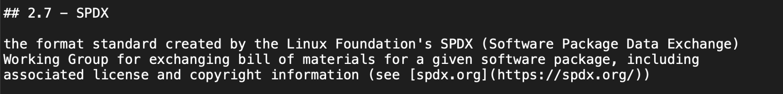
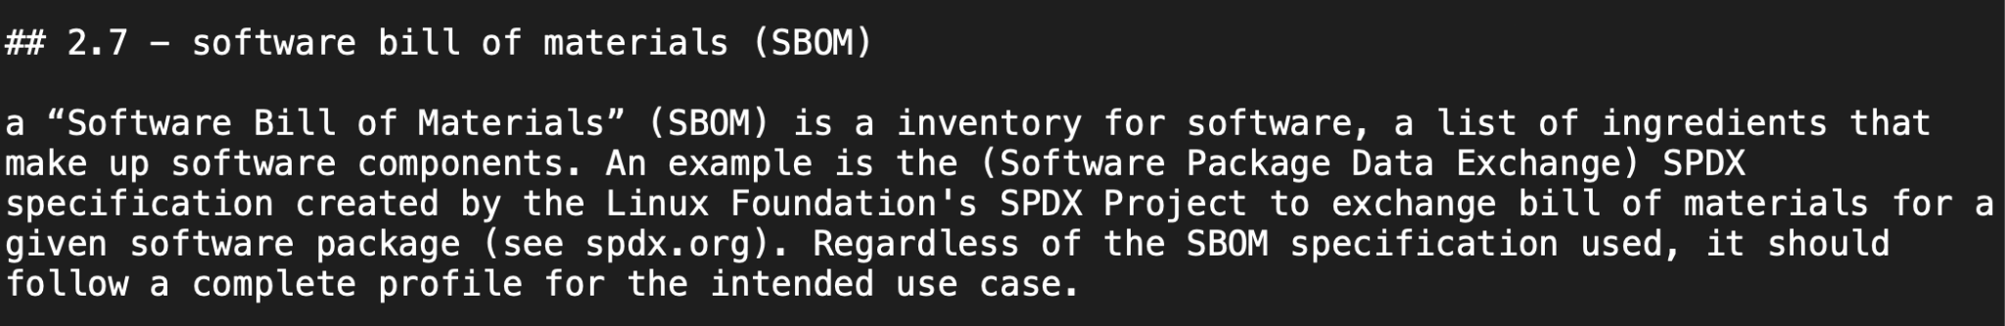
Suggestion #3 for ISO/IEC 5230:2020

Slide 23
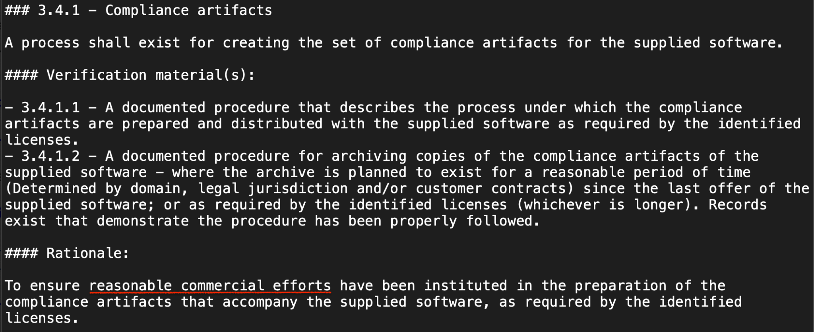
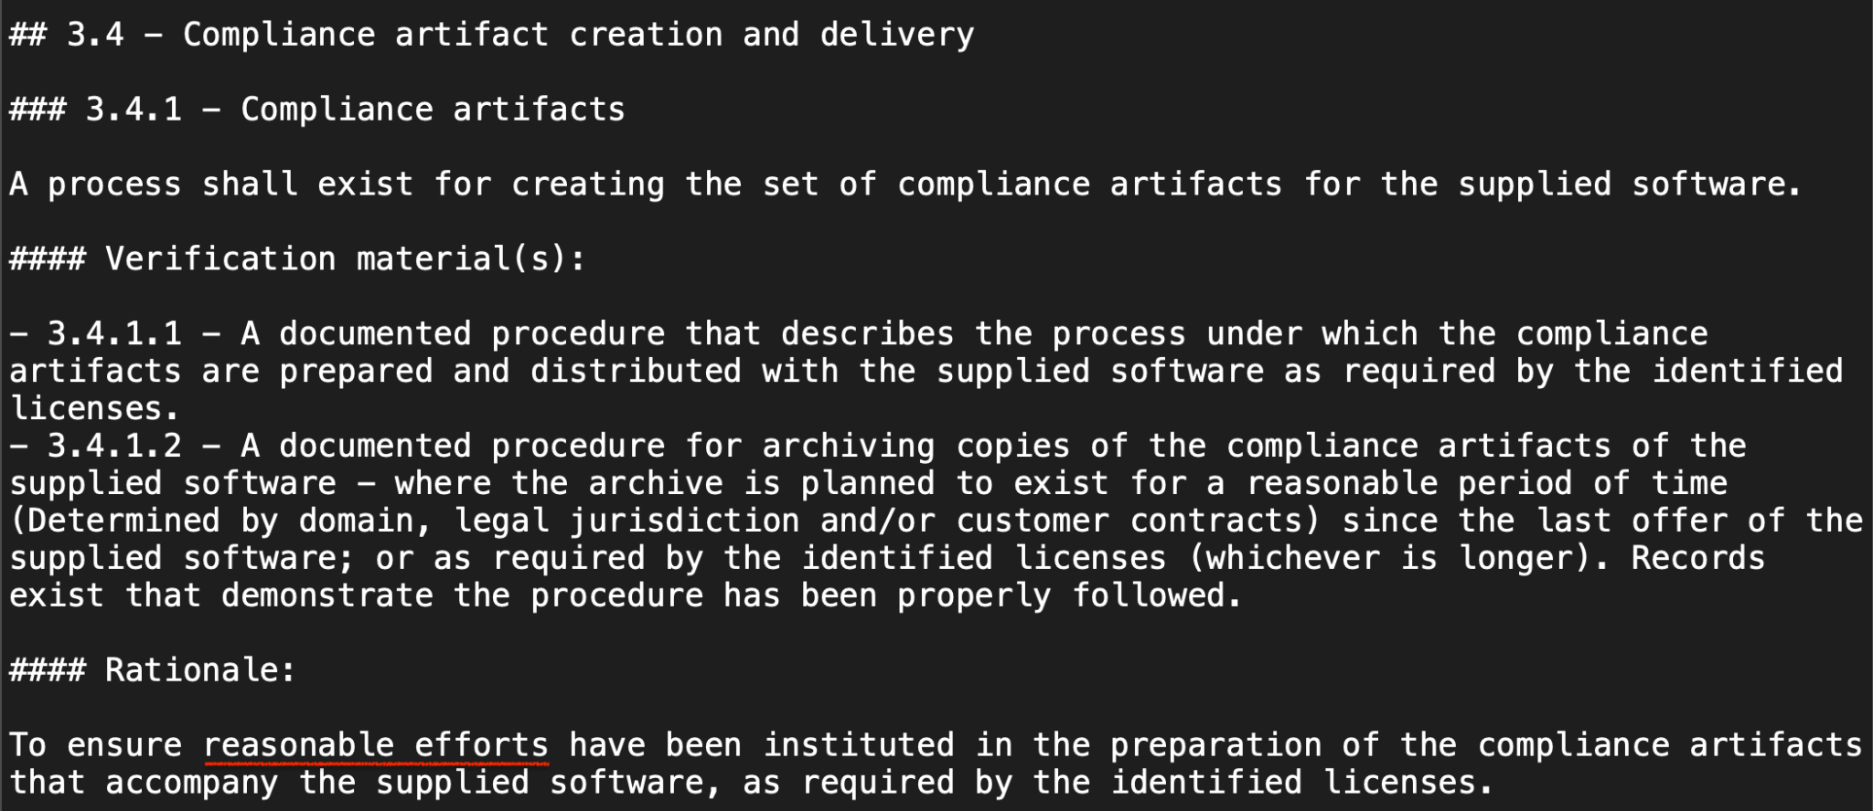
Suggestion #4 ISO/IEC 5230:2020

Slide 24
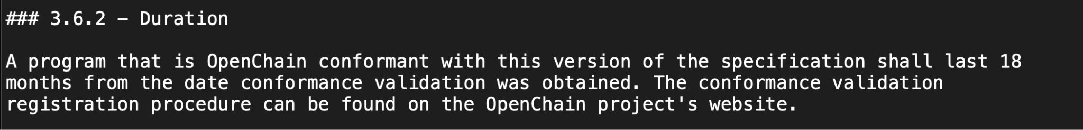

Suggestion #5 for ISO/IEC 5230:2020

Slide 25
Next Five Slides: REDLINE Details for ISO/IEC 18974

Slide 26
Context: The Links To Relevant Documents
Current ISO standard:
https://github.com/OpenChain-Project/Security-Assurance-Specification/blob/main/Security-Assurance-Specification/ISO-18974/en/ISO-18974.md
Current Next Generation Draft (pre-public comments period):
https://github.com/OpenChain-Project/Security-Assurance-Specification/blob/main/Security-Assurance-Specification/2.0/en/openchain-security-specification-2.0.md
All open issues have been closed by the Specification Work Group
https://github.com/OpenChain-Project/Security-Assurance-Specification/issues?q=is%3Aissue+is%3Aclosed

Slide 27
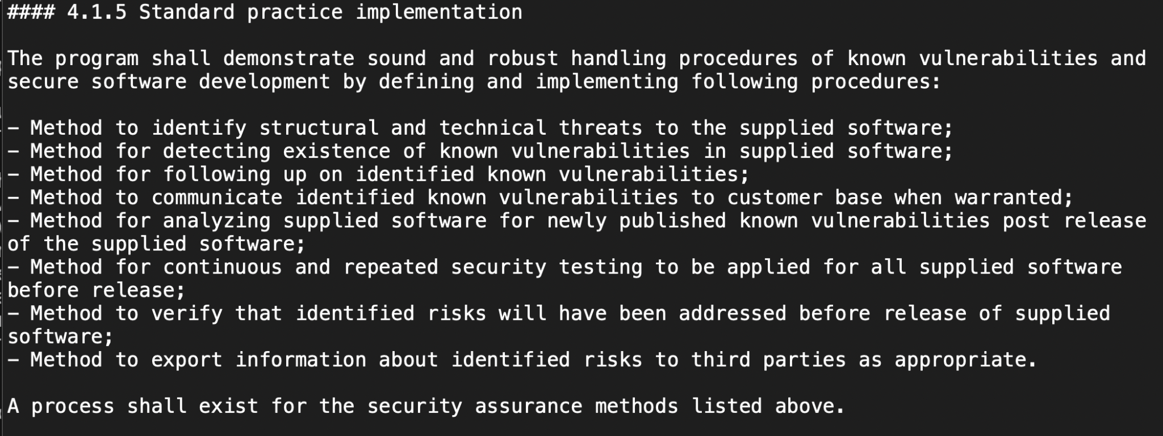
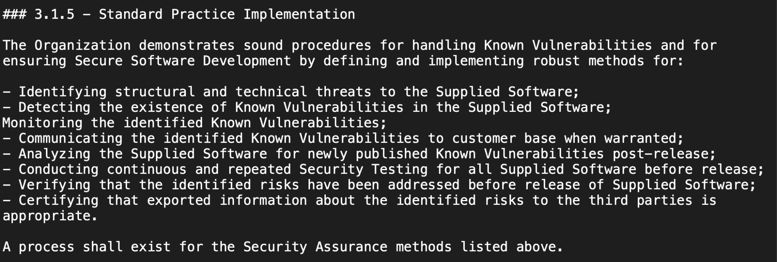
Suggestion #1 for ISO/IEC 18974:2023

Slide 28
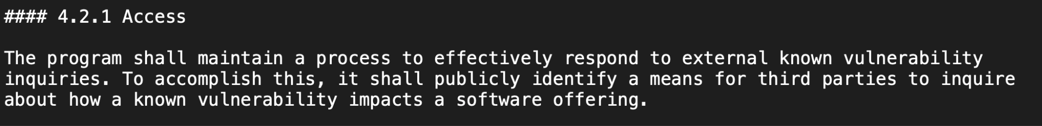
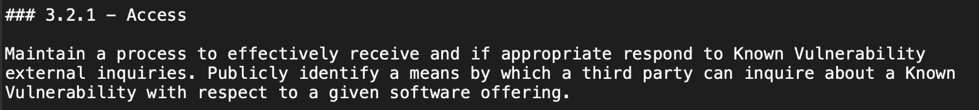
Suggestion #2 for ISO/IEC 18974:2023

Slide 29
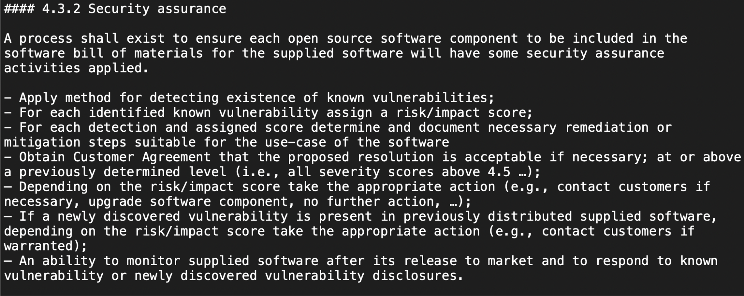
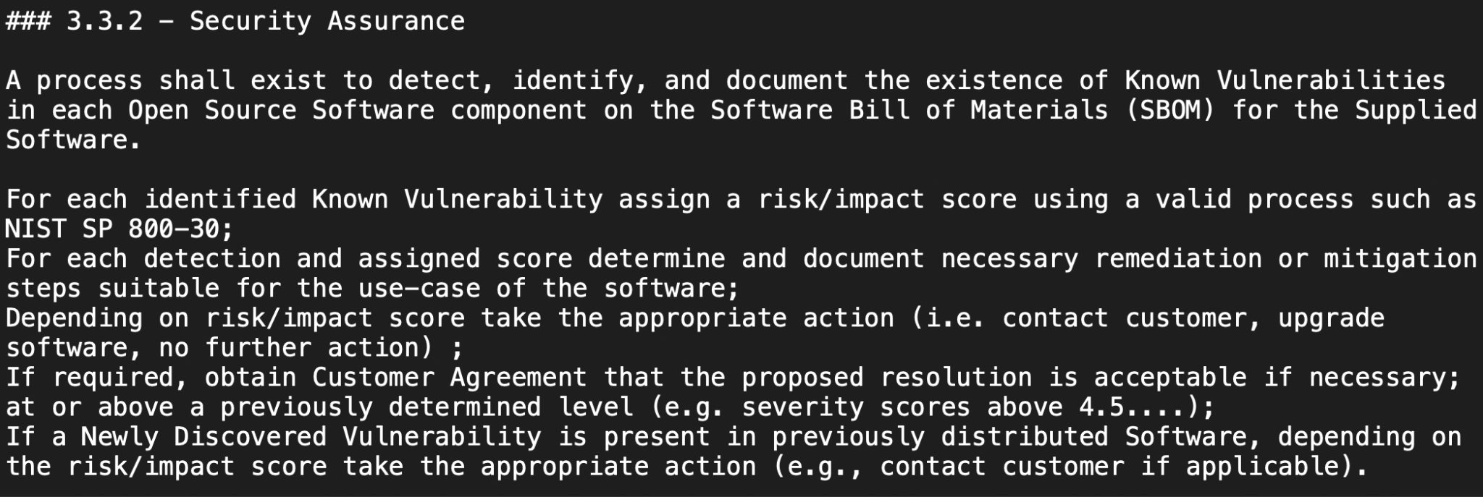
Suggestion #3 for ISO/IEC 18974:2023

Slide 30
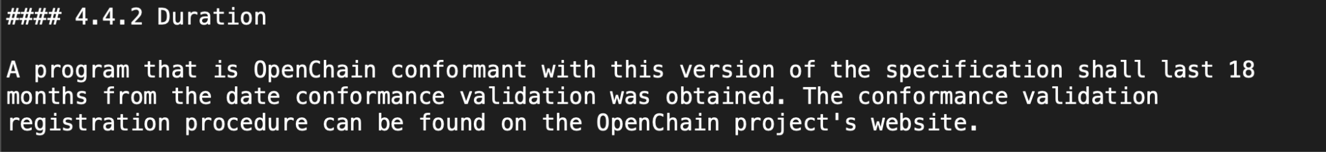

Suggestion #4 for ISO/IEC 18974:2023

Slide 31
Other News! Proposed Survey – Comments?
Rationale:
The OpenChain Specification Work Group is launching a survey to explore community feedback around ISO/IEC 5230 for open source license compliance and ISO/IEC 18974 for open source security assurance. Our goal is to focus energy for future editing based on real-world requirements.
ExampleQ1:
Have you found shortfalls in ISO/IEC 5230 regarding how it addresses open source license compliance process management?
ExampleQ2:
If so, were these shortfalls based on processes areas it did not cover?
ExampleQ3:
If so, were these shortfalls based on complexity?
ExampleQ4:
If so, were these shortfalls based on number of requirements?
ExampleQ5:
Have you found shortfalls in ISO/IEC 18974 regarding how it addresses open source security assurance process management?
ExampleQ6:
If so, were these shortfalls based on processes areas it did not cover?
ExampleQ7:
If so, were these shortfalls based on complexity?
ExampleQ8:
If so, were these shortfalls based on number of requirements?
ExampleQ9:
Have you found any disconnect between the requirements of ISO/IEC 5230 and ISO/IEC 18974 that caused confusion?
ExampleQ10:
Have you found any disconnect between the requirements of ISO/IEC 5230 and ISO/IEC 18974 that hindered cross-adoption?

Slide 32
Any other business?

Slide 33
Close of meeting

Slide 34
See you next time!

